Slide 1
Byzantine Generals Problem

Slide 2
Problems in Distributed Systems
Failed nodes cannot receive messages or send conflicting information to the others.
Good nodes:
Agree to to the same thing.
Bad nodes:
Faulty nodes generate corrupted and conflicting messages.
Non-malicious nodes may not be reachable due to software bugs, H/W, or network failures.
Malicious nodes alter messages by hackers.

Slide 3
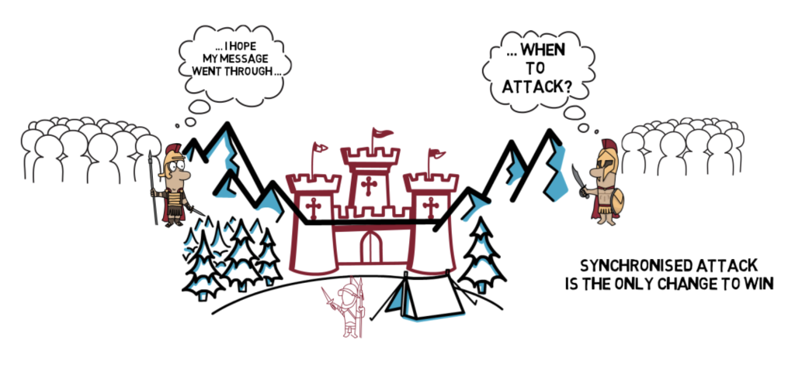

Slide 4
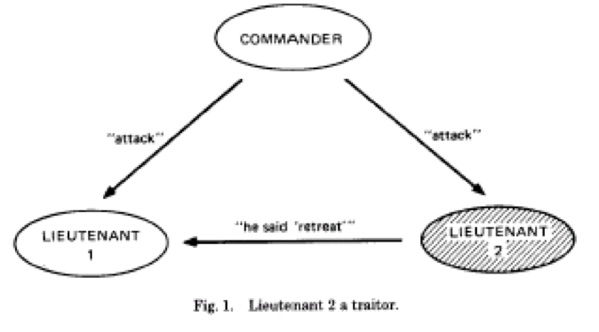
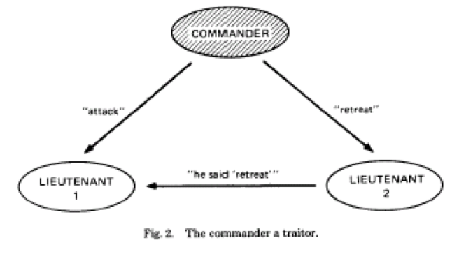
3-General Impossibly

Slide 5
Generals Problem
Generals = nodes
Requirements:
G1: All loyal generals decide upon the same plan of action on the attack.
G2: A small number of traitors cannot cause the loyal generals to execute a bad plan.
Oral Messages (OM) Interactive Consistency Goals:
IC1: All loyal lieutenants obey the same order.
IC2: If the commanding general is loyal, then every loyal lieutenant obeys the order he sends.
Solution: (3m + 1) generals for m traitors.

Slide 6
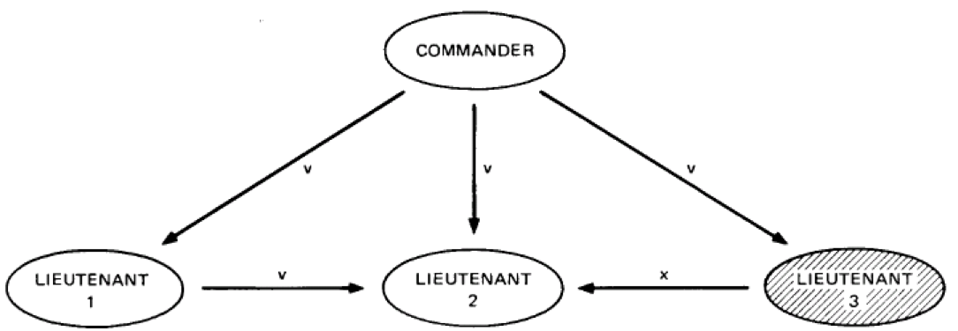
Example: n = 4, m = 1

Slide 7
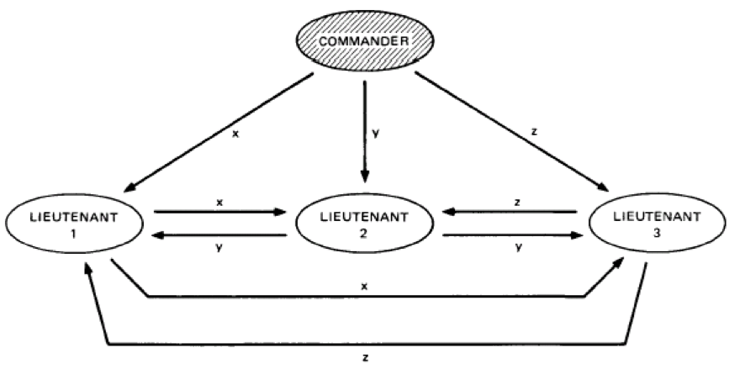
Example: n = 4, m = 1

Slide 8
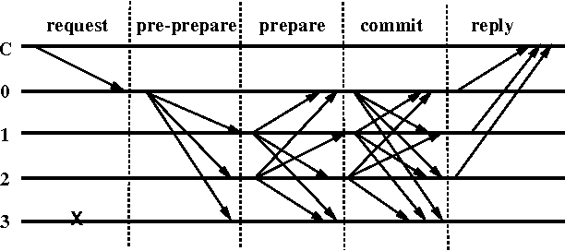
Byzantine Agreement Steps

Slide 9
Federated Byzantine Agreement (FBA)
Each node does not have to be known and verified ahead of time.
Open membership and control is decentralized.
Nodes can choose whom they trust.
System-wide quorums emerge from decisions made by individual nodes.

Slide 10

Quorum Slice
A quorum is the number of nodes required to reach agreement.
A quorum slice is a subset of a quorum which can convince another specific to agree.
A node can reply upon numerous slices and the choices depend on extrinsic criteria including external sources.

Slide 11
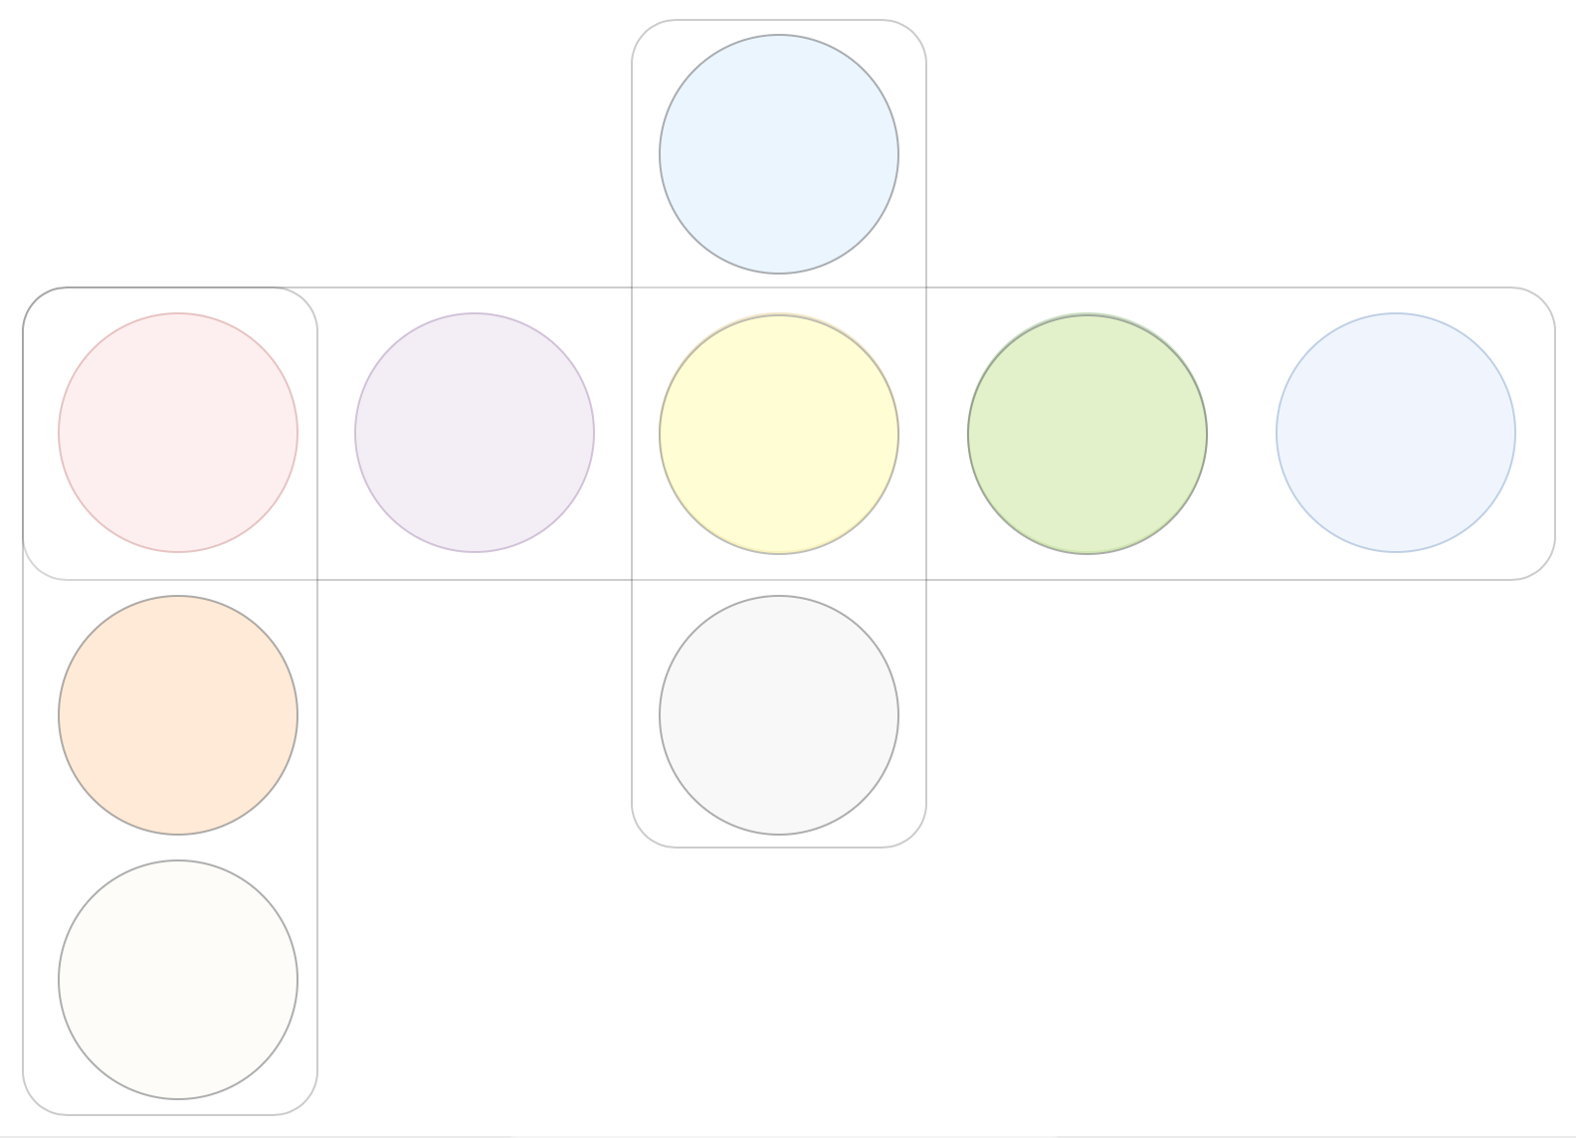
Quorum Intersections
A good quorum shares nodes
resulting in quorums
that overlap.

Slide 12

Disjoint Quorums

